Slide 1

SQL Database
Cale

Slide 2

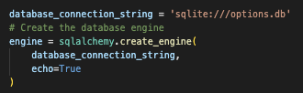
Create “Options” Database
While the analysis runs from the csv files, storing the data in a database will provide easy access for future use.
In this project, we used SQLite to create tables for each day of data.

Slide 3
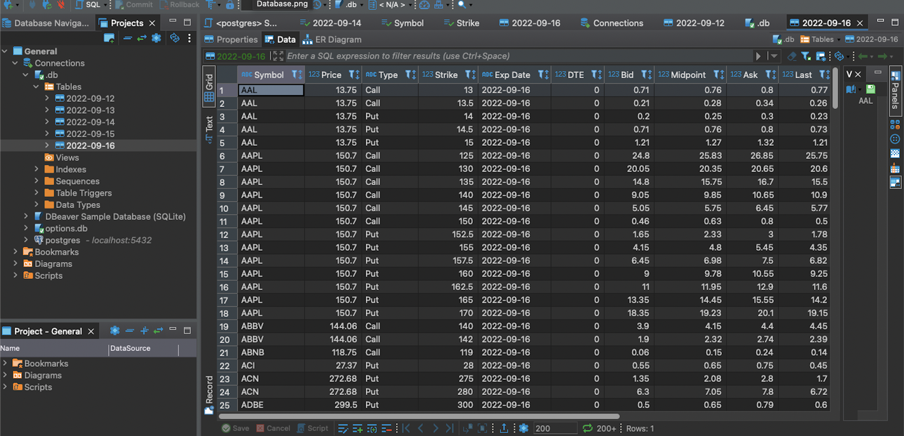
Daily Tables In the Database
We can query the database and manipulate the data as desired for analysis.

